Slide 1


ECE-5508 Final Project
Cyclic Redundancy Check in SystemVerilog
Brandon Starks & Barrett Durtschi

Slide 2
Background
BES
Information and Coding Theory …
Sub-field of Communications Theory.
Deals with Error Detection and Error Correction.
Why care?
Receiver has no knowledge of information sent.
Receiver would never know if errors seeped into message.
With techniques in this field, redundant data can be sent with original message to allow receiver to detect or correct errors in received message.

Slide 3
Cyclic Redundancy Check
BES
Algorithm that allows a receiver to detect errors.
Transmitter computes CRC bits given a divisor and data bits.
Done using modulo-2 division.
Data is dividend.
CRC is the remainder.
Transmitter send original data with CRC bits.
Receiver deconstructs data and uses CRC to check for error.
Separate CRC from received data.
Perform same computation done by transmitter.
Compare calculated CRC with received CRC.

Slide 4
CRC cont.
BDD
CRC is one of the simplest forms of ED and can detect if there has been a single-bit flip or greater error in a sent communication.
Our project has expanded the base modulo-2 to allow for more complexity which will be explained in the code section

Slide 5
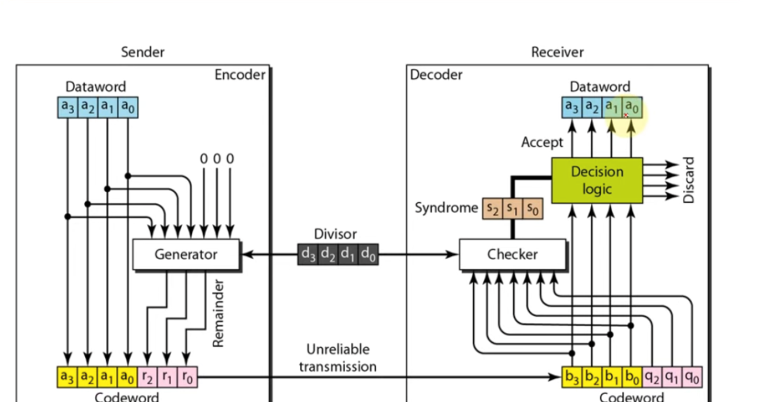
Basic CRC Diagram
BDD

Slide 6
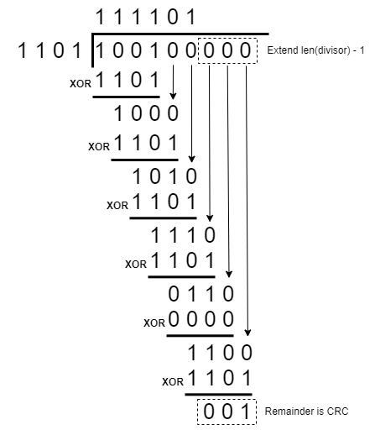
E.g. (Generalized CRC Tx)
BES
Data: 100100
Divisor: 1101
Tx: 100100001

Slide 7
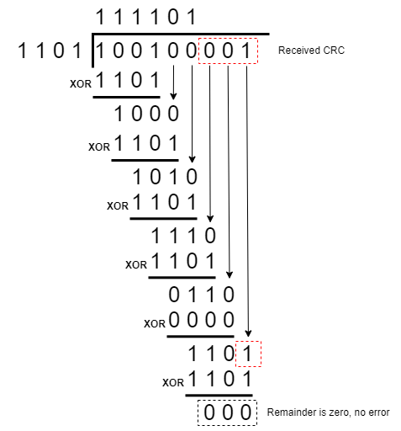
E.g. (Generalized CRC Rx)
BES
Rx: 100100001
Divisor: 1101
Remainder: 000

Slide 8
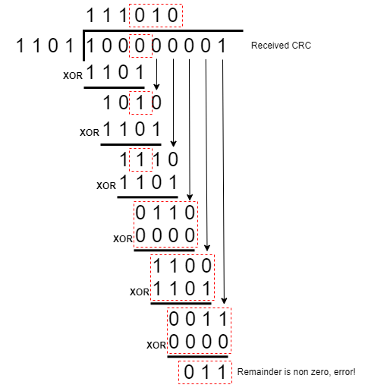
E.g. (Generalized CRC Rx Error)
BES
Rx: 100100001
Divisor: 1101
Remainder: 000

Slide 9
Project Scope / Progression
BDD
•Python Simulation (showed in the proposal) of a 16-bit CRC
•Programmed a checksum to be created by using shift registers, input data, and polynomial.
•Showed that the decoder accurately could decode a message, and if checksum was changed could accurately detect there was an error during transmission.
•See next slides for visual representation of encoder/decoder

Slide 10
Python Proof of Concept (Encoder)
BDD
def crc_8_encode(data: int, poly: int = 0x9B) -> int:
"""Function to encode one byte of data with a one
byte CRC checksum. Format of the encoded data is:
bits [15-8] -> data, bits [7-0] -> crc checksum.
Arguments:
data (int): The 8 bit data word to encode with CRC.
Returns:
The original data with a 8 bit CRC checksum
appended after the LSB of the data.
"""
# The initial value of the CRC register
crc = 0xff
...
...
# Iterate over each bit of the data word
for i in range(8):
# If the current bit of the CRC register is 1
if crc & 0x80:
# XOR the CRC register with the polynomial
crc = (crc << 1) ^ poly
else:
# Shift the CRC register to the left
crc = crc << 1
# If the current bit of the data word is 1
if data & (1 << (7-i)):
# XOR the CRC register with the data word
crc = crc ^ 0x01
# Return the final value of the CRC register as an
# 8-bit integer.
return crc & 0xFF

Slide 11
Python Proof of Concept (Decoder)
BES
def crc_8_decode(data: int, crc: int, poly: int = 0x9B) -> int:
"""Function to decode a four bytes of data with a two
byte CRC checksum to verify the integrity of the data.
Arguments:
data (int): The 16 bit data word to decode with CRC.
poly (int): The polynomial of the CRC decoder.
Returns:
The calculated CRC checksum which should match the
checksum provided with the data.
"""
# The initial value of the CRC register
crc_register = 0xFF
...
...
# Iterate over each bit of the data word
for i in range(8):
# If the current bit of the CRC register is 1
if crc_register & 0x80:
# XOR the CRC register with the polynomial
crc_register = (crc_register << 1) ^ poly
else:
# Shift the CRC register to the left
crc_register = crc_register << 1
# If the current bit of the data word is 1
if data & (1 << (7-i)):
# XOR the CRC register with the data word
crc_register = crc_register ^ 0x01
# If the final CRC value is 0, the CRC check passed
if crc_register & 0xFF == crc:
return True
else:
return False

Slide 12
E.g. (Implemented CRC Algorithm)
BES
CRC Register | Polynomial | (CRC<<1) ^ Poly | Data | CRC ^ Data Bit
11111111 | 10011011 | 01100101 | 11001010 | 01100100
01100100 | 10011011 | Only LLS Once | 11001010 | 11001001
11001001 | 10011011 | 00001001 | 11001010 | No need to XOR with 0
00001001 | 10011011 | Only LLS Once | 11001010 | No need to XOR with 0
00010010 | 10011011 | Only LLS Once | 11001010 | 00100101
00100101 | 10011011 | Only LLS Once | 11001010 | No need to XOR with 0
01001010 | 10011011 | Only LLS Once | 11001010 | 10010101
10010101 | 10011011 | 10110001 | 11001010 | No need to XOR with 0
10110001

Slide 13
Summary of Python Simulations
BDD
Encoder and Decoder functions created
Encoder takes the input data and set polynomial to calculate the checksum
Checksum is passed to Receiver and XORed with the polynomial (same process as encoder) to receive the remainder
If remainder returns 0, the test passes and it is known that the original dataword was received. If remainder returns 1, the test fails and we know we have a >=1 bit error

Slide 14
Changes from Proposal
BDD
•Realized that 16-bits (32-bit with appended checksum) would be very hard to visually implement on the BASYS 3 board.
•Changed to 8-bits (doesn’t really affect overall project scope other than we can’t transfer/verify as many bits on the receiving end)

Slide 15
SystemVerilog (Encoder)
BDD
module crc_8_encoder(
input logic [7:0] data, // Data is used to calculate checksum with poly.
output logic [7:0] checksum // Checksum calculated for 0 result of XOR.
);
int unsigned poly = 8'h9b; // Internal variable for polynomial.
int unsigned crc = 16'h00ff; // Internal variable for CRC register.
always @(data) begin
crc = 16'h00ff; // Reinitialize the CRC register for the modulo 2 division.
for (int i = 0; i < 8; i++) begin // Iterate over each literal in dataword.
if (crc & 8'h80) // If current bit of crc register is 1.
crc = (crc << 1) ^ poly; // XOR CRC variable with polynomial.
else //
crc = crc << 1; // Shift CRC register to left.
//
if (data & (1 << (7-i))) // If current literal in dataword is 1 ...
crc = crc ^ 8'h01; // XOR CRC register with dataword.
end //
//
checksum = crc & 8'hff; // Only take 8 LSBs for checksum
end
endmodule

Slide 16
SystemVerilog (Decoder)
BES
module crc_8_decoder(
input logic [7:0] data, checksum, // Data and checksum used to calculate result.
output logic [7:0] result // Result indicates if data received contains error (nonzero).
);
int unsigned poly = 8'h9b; // Internal variable for polynomial.
int unsigned crc = 16'h00ff; // Internal variable for CRC register.
always @(data, checksum) begin
crc = 16'h00ff; // Reinitialize the CRC register for the modulo 2 division.
for (int i = 0; i < 8; i++) begin // Iterate over each literal in dataword.
if (crc & 8'h80) // If current bit of crc register is 1.
crc = (crc << 1) ^ poly; // XOR CRC variable with polynomial.
else //
crc = crc << 1; // Shift CRC register to left.
//
if (data & (1 << (7 - i))) // If current literal in dataword is 1 ...
crc = crc ^ 8'h01; // XOR CRC register with dataword.
end //
//
result = checksum - (crc & 8'hff); // Compare calculated checksum with supplied.
end
endmodule

Slide 17
SystemVerilog Testbenches
BES
Split the Encoder and Decoder module into two separate Test Benches
Encoder
Encoder utilizes the input data word and outputs the Checksum from Poly and CRC
Waveforms show the signal changes of the dataword, CRC, and output checksum.
Decoder
Decoder takes the checksum along with polynomial to output the final result
Waveforms of data, checksum, and result are shown.
Result is a high or low signal based on if message has been changed from sender.

Slide 18
SystemVerilog TB (Encoder)
BES
module crc_8_encoder_testbench();
logic [7:0] data, checksum; int unsigned crc_reg;
crc_8_encoder dut (data, checksum, crc_reg);
initial begin
$monitor( "data=%b, checksum=%b", data, checksum);
data = 0; checksum = 0;
#50 data = 8'hde; #25 assert (checksum == 8'ha5) $display("pass");
else $display("Checksum %b (%x) DNE %b (%x)", checksum, checksum, 8'ha5, 8'ha5);
#25 data = 8'hbe; #25 assert (checksum == 8'hc5) $display("pass");
else $display("Checksum %b (%x) DNE %b (%x)", checksum, checksum, 8'hc5, 8'hc5);
#25 data = 8'hca; #25 assert (checksum == 8'hb1) $display("pass");
else $display("Checksum %b (%x) DNE %b (%x)", checksum, checksum, 8'hb1, 8'hb1);
#25 $finish;
end
endmodule

Slide 19
SystemVerilog TB (Decoder)
BES
module crc_8_decoder_testbench();
logic [7:0] data, checksum, result; int unsigned crc_reg;
crc_8_decoder dut (data, checksum, result, crc_reg);
initial begin
$monitor( "data=%b, checksum=%b, result=%b", data, checksum, result);
data = 0; checksum = 0;
#50 data = 8'hde; checksum = 8'ha5; #25 assert (result == 8'h00) $display("pass");
else $display("Result %b (%x) DNE %b (%x)", result, result, 8'h00, 8'h00);
#25 data = $random & 8'hde; checksum = $random & 8'ha5; #25 assert (result != 8'h00) $display("pass");
else $display("Result %b (%x) DNE %b (%x)", result, result, 8'h00, 8'h00);
#25 data = 8'hbe; checksum = 8'hc5; #25 assert (result == 8'h00) $display("pass");
else $display("Result %b (%x) DNE %b (%x)", result, result, 8'h00, 8'h00);
#25 data = $random & 8'hbe; checksum = $random & 8'hc5; #25 assert (result != 8'h00) $display("pass");
else $display("Result %b (%x) DNE %b (%x)", result, result, 8'h00, 8'h00);
...

Slide 20
SystemVerilog TB (Decoder)
BES
...
#25 data = 8'hca; checksum = 8'hb1; #25 assert (result == 8'h00) $display("pass");
else $display("Result %b (%x) DNE %b (%x)", result, result, 8'h00, 8'h00);
#25 data = $random & 8'hca; checksum = $random & 8'hff; #25 assert (result != 8'h00) $display("pass");
else $display("Result %b (%x) DNE %b (%x)", result, result, 8'h00, 8'h00);
#25 $finish;
end
endmodule

Slide 21
Encoder Waveforms
BDD

Slide 22
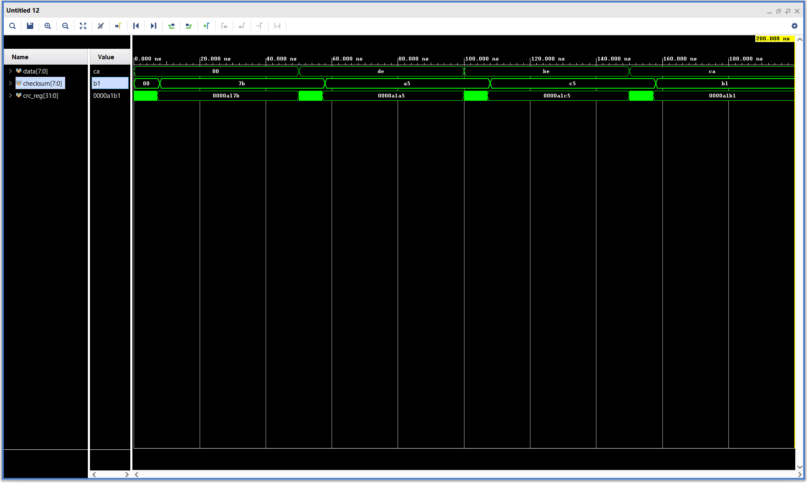
Encoder Waveforms

Slide 23
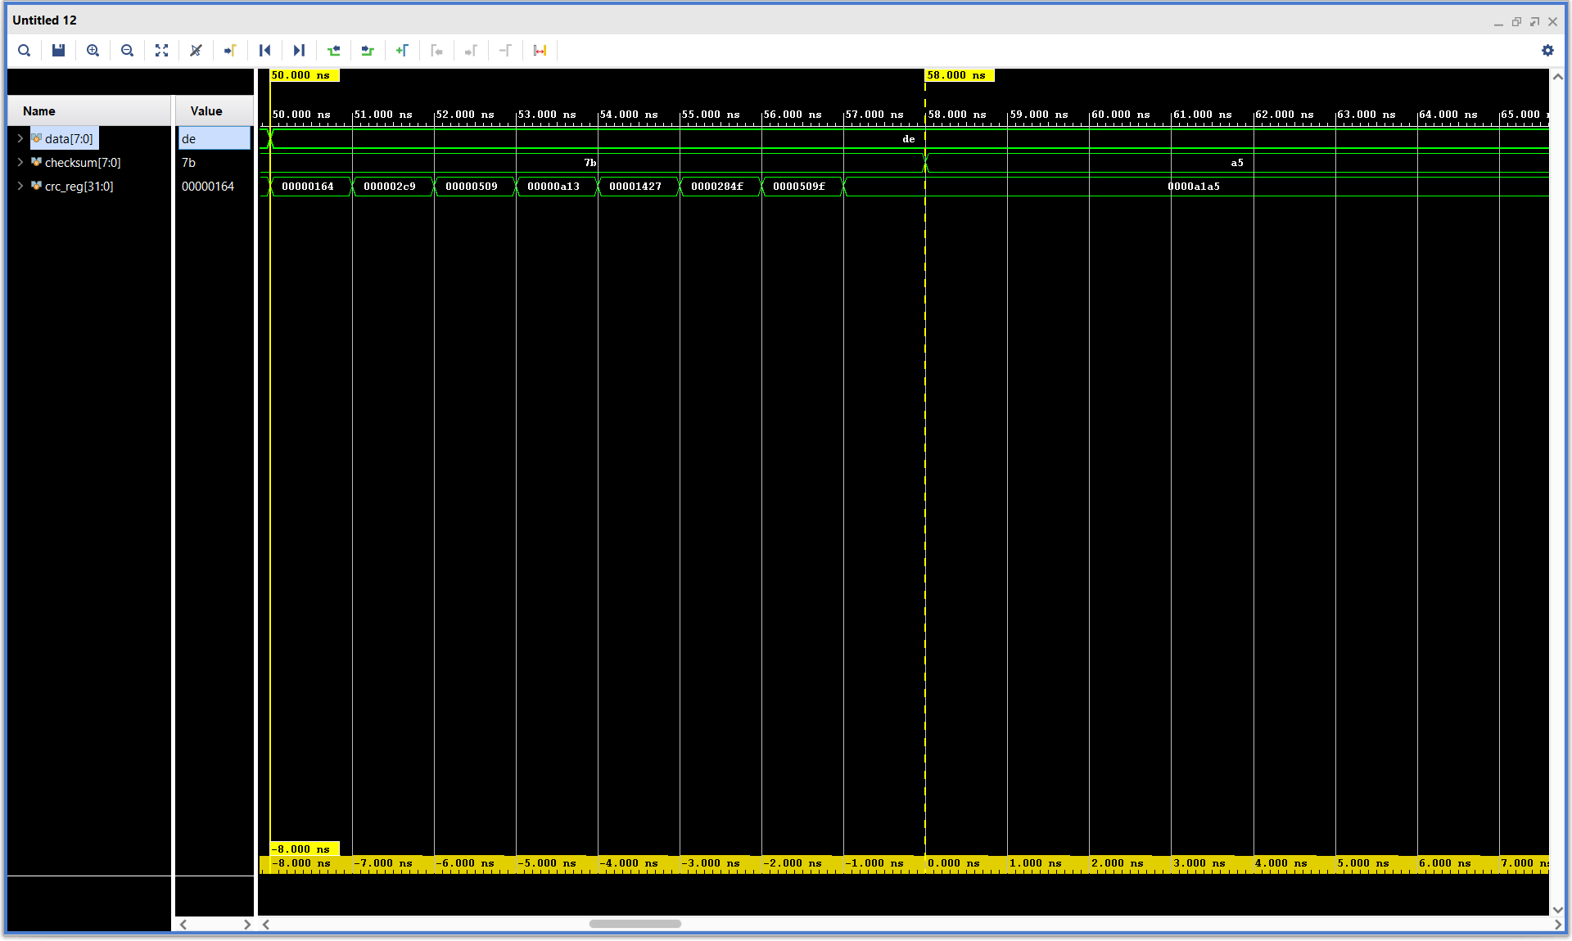

Slide 24
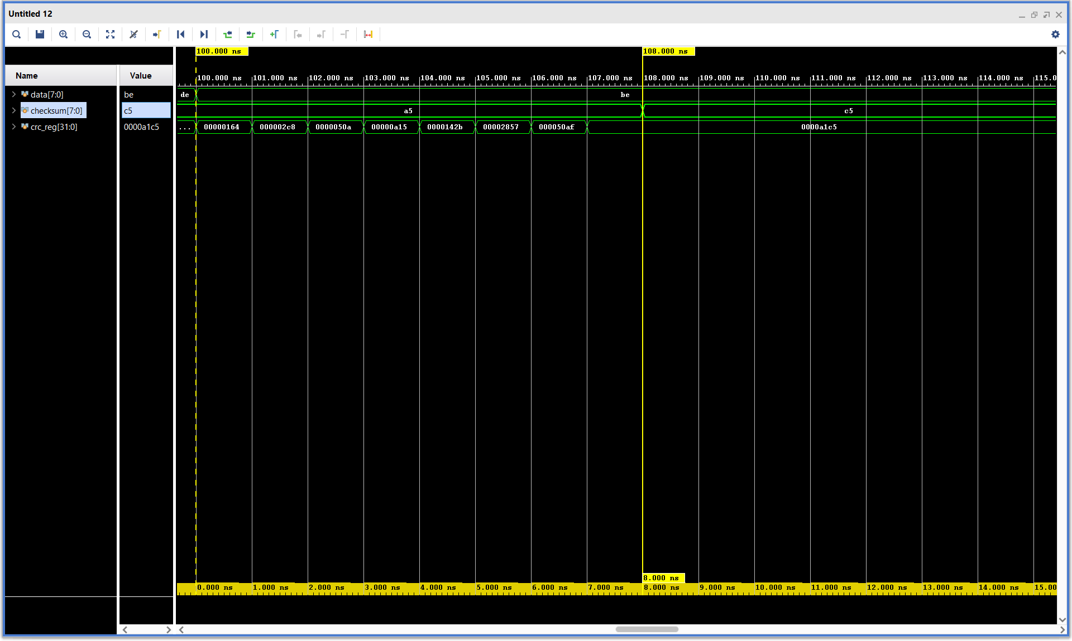

Slide 25


Slide 26
Decoder Waveforms
BES

Slide 27
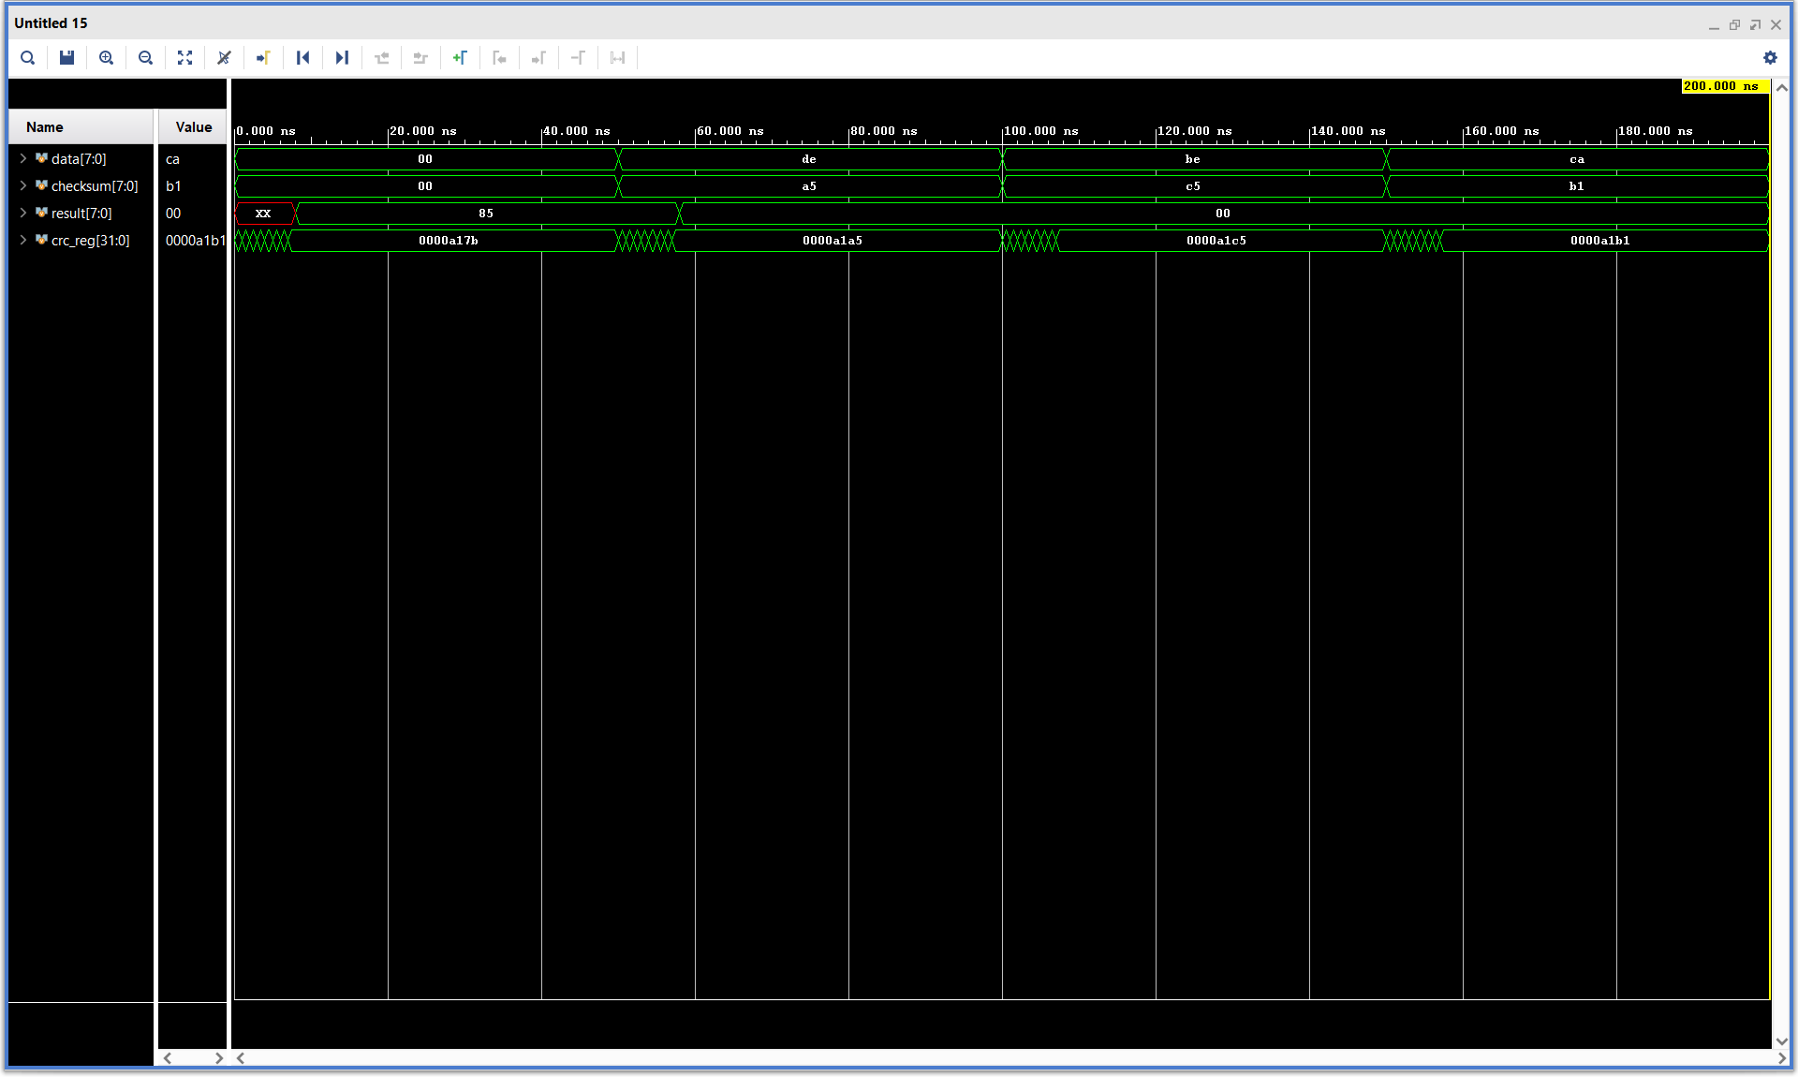

Slide 28
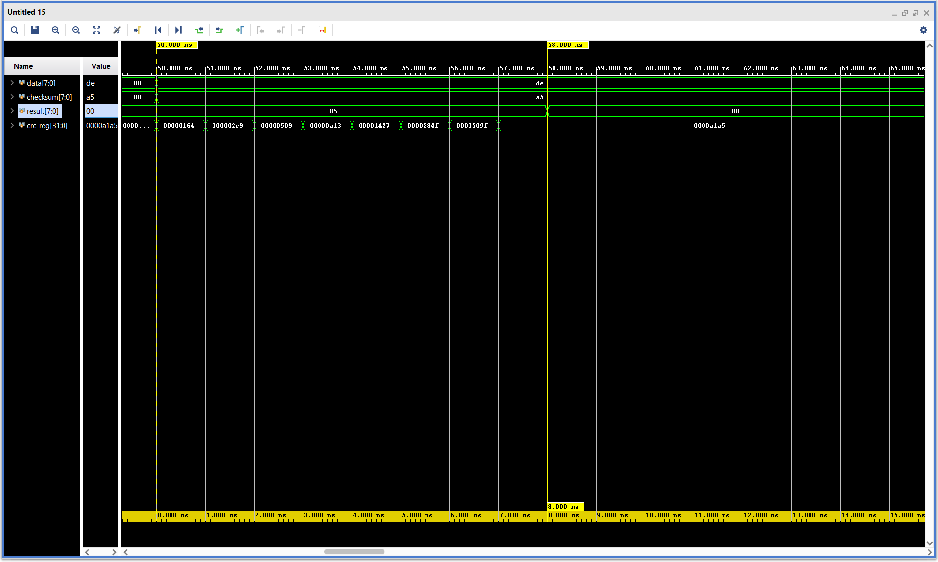

Slide 29
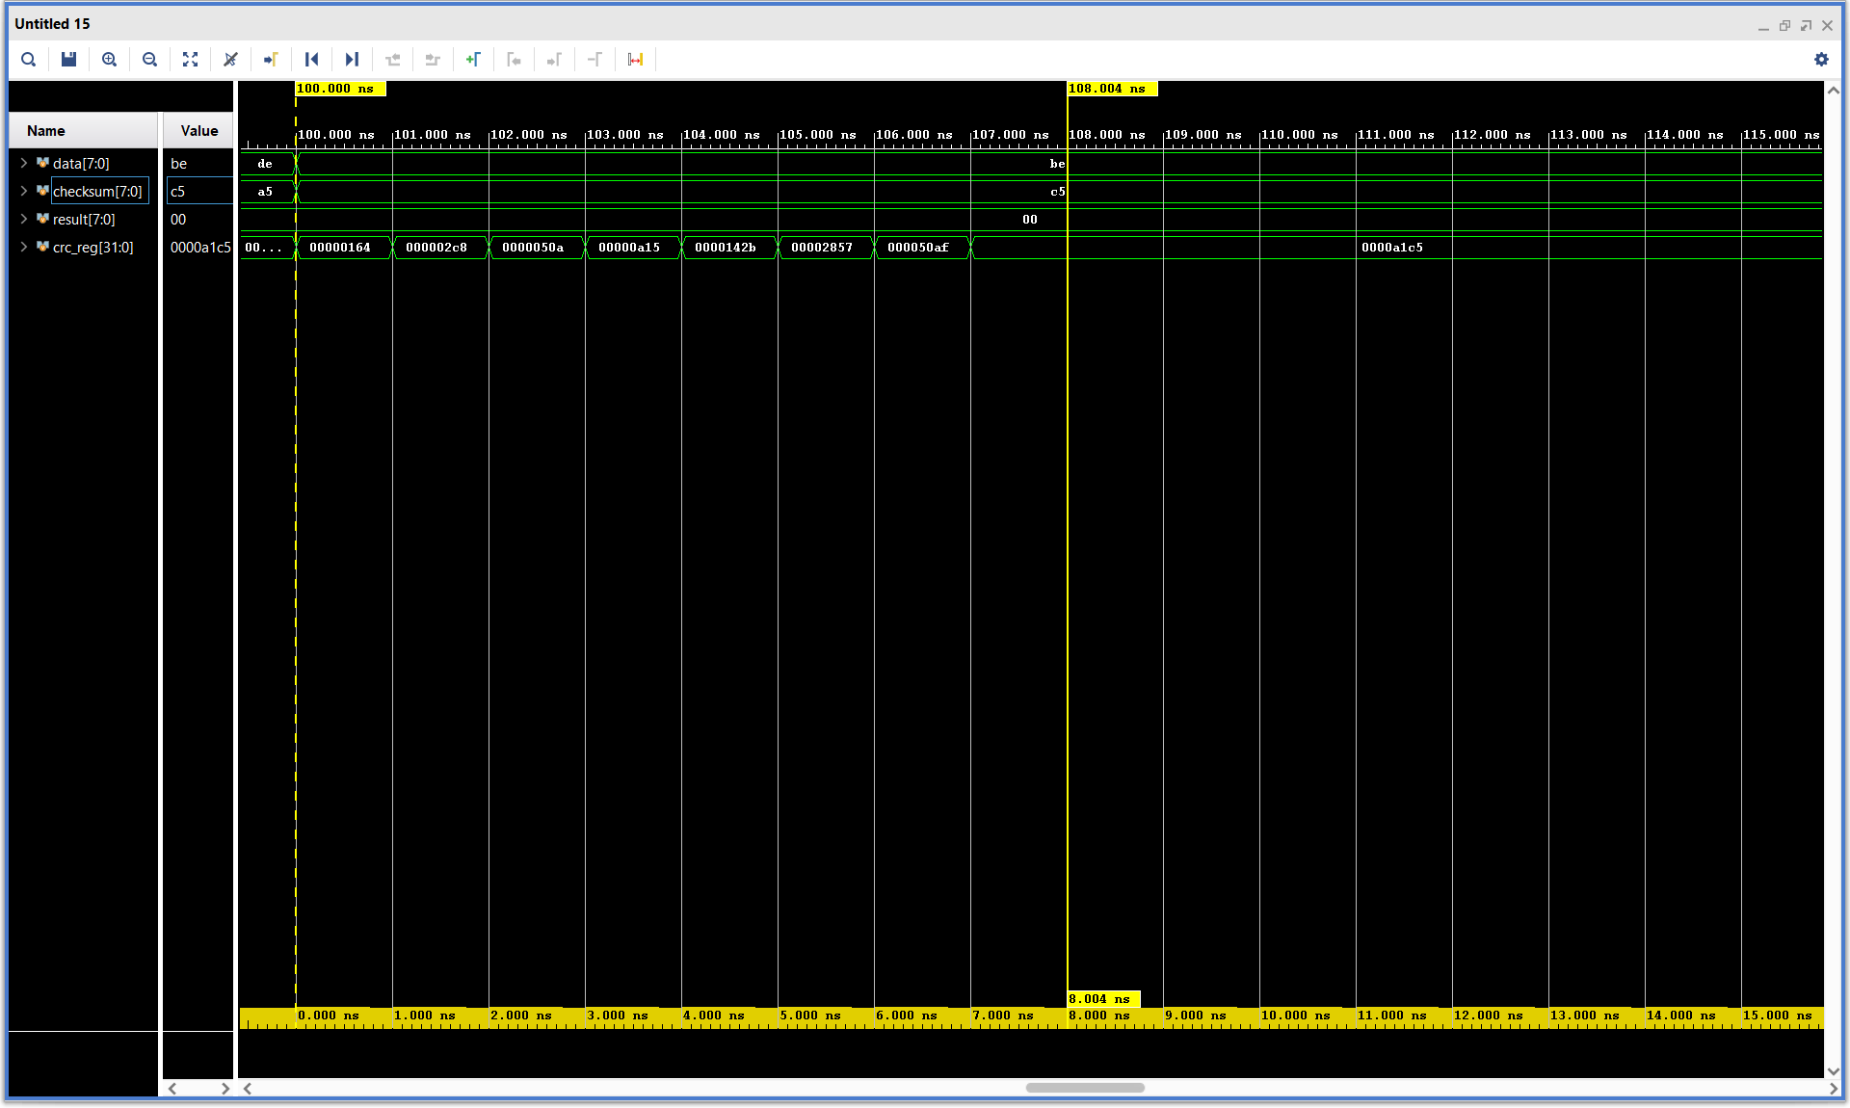

Slide 30
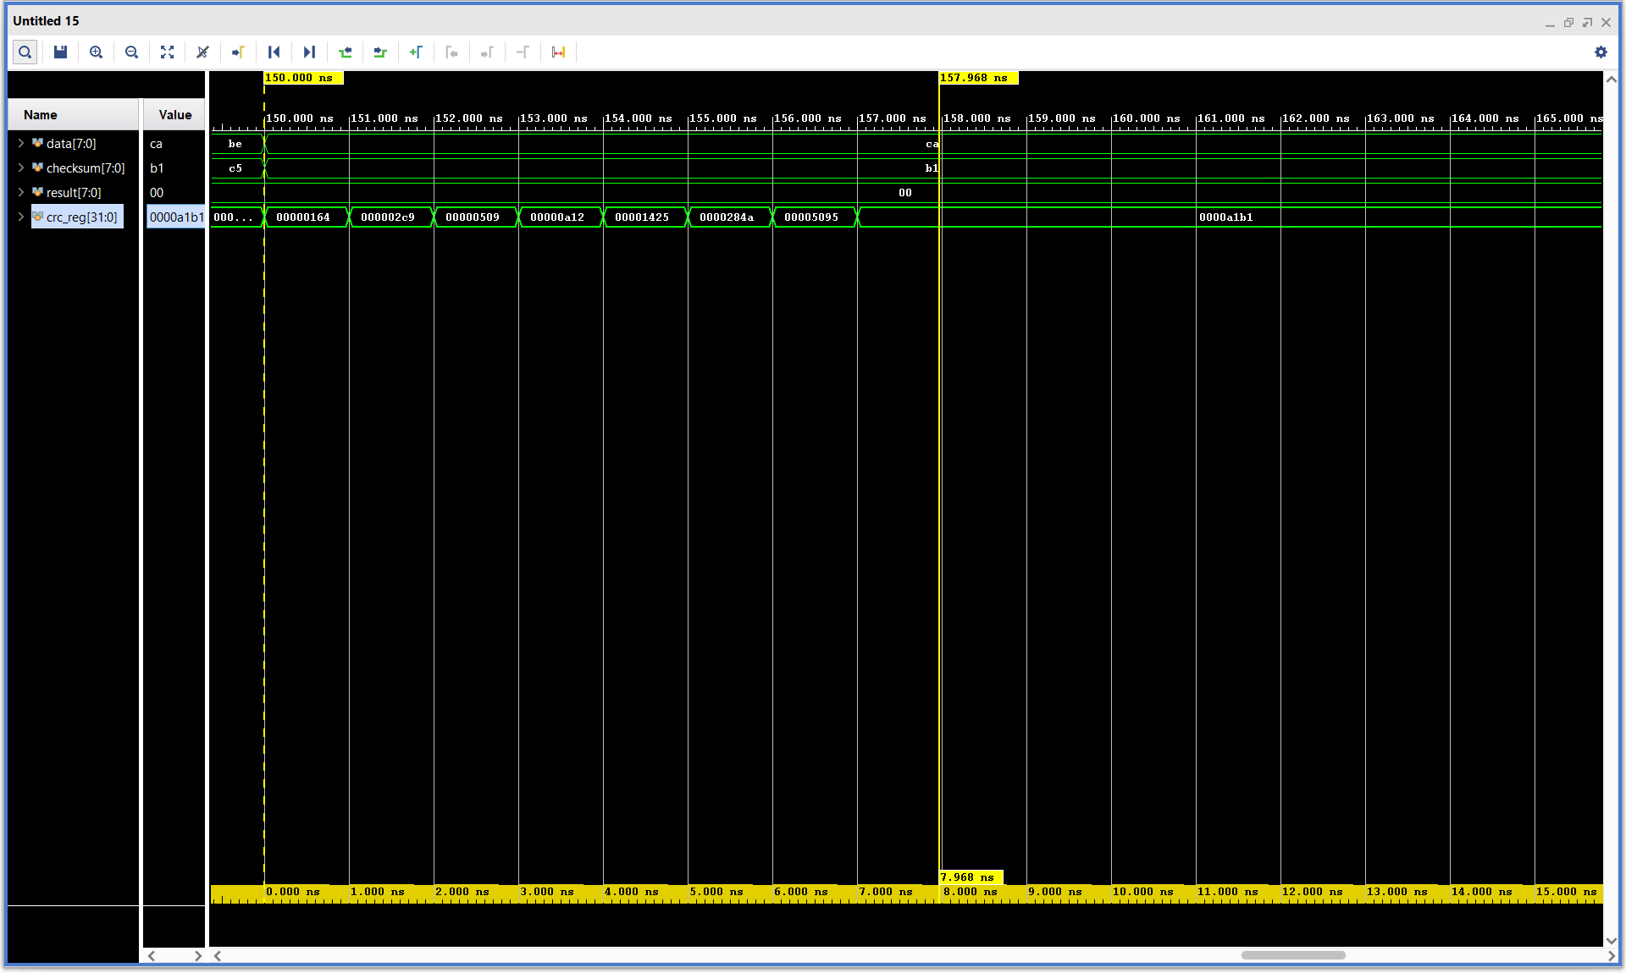

Slide 31
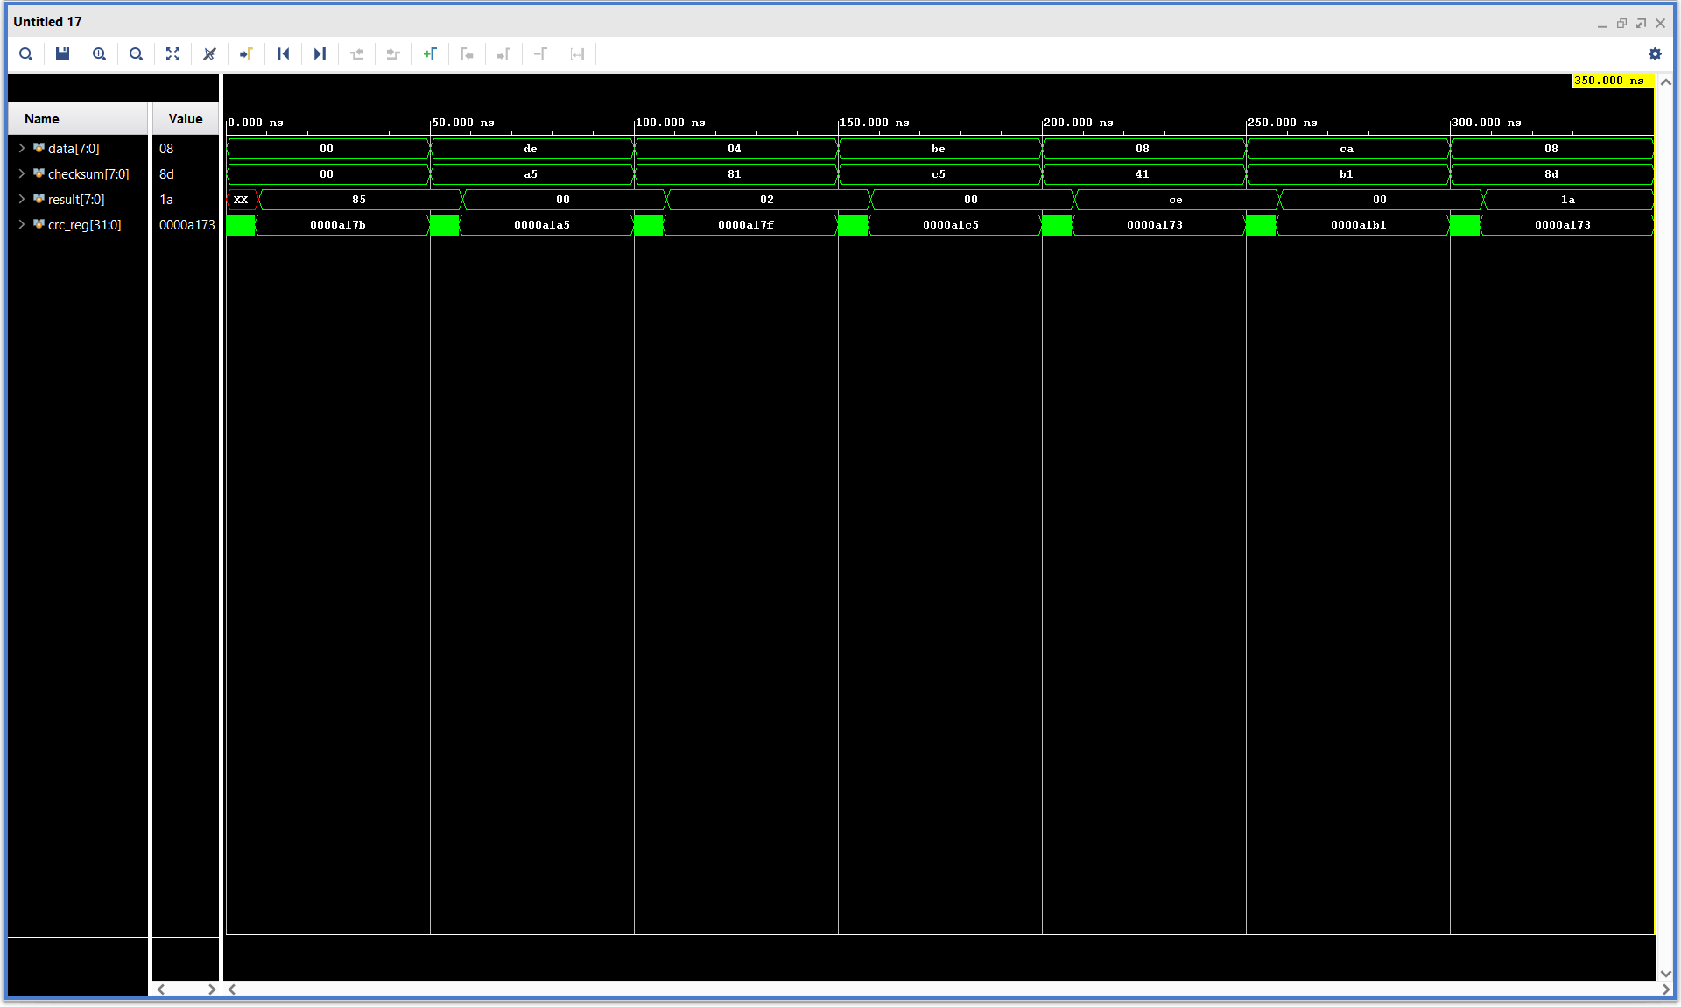

Slide 33
Implementation
BDD
•Last eight switches of the board were used for the user input or ‘DataWord’. (R2, T1, U1, W2, R3, T2, T3, V2)
•Eight LEDs show the user input (W13, W14, V15, W15, W17, W16, V16, V17)
•Eight LEDs show the in-progress calculations which are forcibly delayed (L1, P1, N3, P3, U3, V3, W3, V13)
•Result value is output to 7 segment display, 0s indicate the test has passed, 1s indicate message decoding found an error

Slide 34
Presentation of BASYS3 Board
BDD
Link

Slide 35
Analysis of Results
BDD
•Everything performed the same on the BASYS3 board as our Python simulations.
•Implementation on BASYS3 illustrates both the CRC working to detect if there is/isn’t a bit flip in the communication via switches and LEDs.
•Vivado simulation shows a better picture of how the CRC/Checksum is being calculated at each step to show that it is working as it should.

Slide 36
Auxiliary Work
BDD
GitHub Repository
Used for all of our collaborative work to ensure collisions would not occur
Made it easier to assign/review different tasks without repeating work
Significant amount of time went into learning Git which ended up creating a larger knowledge base for future team projects
Ended up completing around 35 issues which shows the organization/extent of our project.

Slide 37
Conclusion
BDD
Python simulations proved the math used on CRC methods
8-bit CRC works as programmed on the BASYS3 FPGA board and testbench waveforms
This CRC can be expanded to a higher bit length on the BASYS3 but is hard to implement visually without additional I/O
GitHub was used as the repository for organization and distribution of work

Slide 38
Questions?
Contact information
Barrett Durtschi: durtbarr@isu.edu
Brandon Starks: starbran@isu.edu

